Slide 1

EditEdit MasterMaster texttext stylesstyles
Practical Lecture : STL Day 1

Slide 2

Quick Recap
Let’s take a quick recap of previous lecture –
Introduction to templates
Function template
class template

Slide 3
Today’s Agenda
Today we are going to cover –
Introduction to STL
Containers
Algorithms and iterators
Container - Vector and List.

Slide 4
C++
Let’s Get Started-

Slide 5
Introduction
We have already understood the concept of C++ Template
The C++ STL (Standard Template Library) is a powerful set of C++ template classes to provide general-purpose classes and functions with templates that implement many popular and commonly used algorithms and data structures like vectors, lists, queues, and stacks.
It is a generalized library and so, its components are parameterized.
At the core of the C++ Standard Template Library are following three well-structured components −
Containers
Algorithms
Iterators
Learning STL is important for every C++ programmer as it saves a lot of time while writing code.

Slide 6
Components
All the three components have a rich set of pre-defined functions which help us in doing complicated tasks in very easy fashion.
Containers
Containers are used to manage collections of objects of a certain kind. There are several different types of containers like deque, list, vector, map etc.
Algorithms
Algorithms act on containers. They provide the means by which you will perform initialization, sorting, searching, and transforming of the contents of containers.
Iterators
Iterators are used to step through the elements of collections of objects. These collections may be containers or subsets of containers.
Will discuss about each component in detail soon

Slide 7
C++
Containers

Slide 8
Containers
Containers are library used to manage collections of classes and objects of a certain kind.
The containers are implemented as generic class templates.
Containers help us to implement and replicate simple and complex data structures very easily like arrays, lists, trees , stack, queues, etc.
For example you can very easily define a linked list in a single statement by using list container of container library in STL , saving your time and effort. It means a linked list template is already defined. You have to simply use it by creating objects from it and calling methods of it.
Containers can be used to hold different kind of objects. It means same container can be operated on any data types , you don’t have to define the same container for different type of elements.

Slide 9
Data structures
Array: is a linear collection of elements of similar data types. Operations possible on array : addition of elements. Addition can be done randomly.
Stack: collection of items arranged on top of each other in the form of pile where elements are inserted and extracted only from one end of the pile.. Stack is a linear data structure which follows a particular order in which the operations are performed. The order may be LIFO (Last In First Out) or FILO (First In Last Out)
Queue: A Queue is a linear structure which follows a particular order in which the operations are performed. specifically designed to operate in a FIFO context (first-in first-out), where elements are inserted into one end of the container and extracted from the other

Slide 10
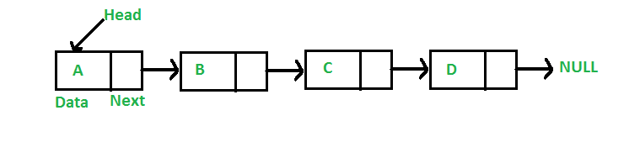
Data structures
Linked list: A linked list is a linear data structure, in which the elements are not stored at contiguous memory locations.
To create a linked list, following structure need to be created. Program will work around this structure.
// A linked list node struct Node { int data; struct Node* next; };

Slide 11
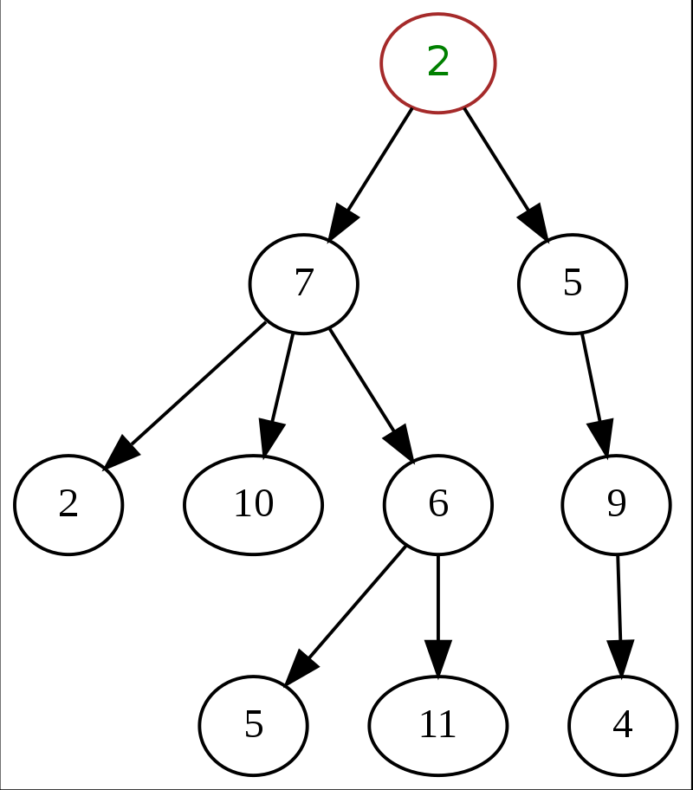
Data structures
Tree: A tree is a nonlinear data structure, compared to arrays, linked lists, stacks and queues which are linear data structures. It is a collection of nodes connected by directed (or undirected) edges.

Slide 12
Common containers
vector: replicates arrays
queue: replicates queue
stack: replicates stack
list: replicates linked list
set: replicates trees
maps: associative arrays
And many more…

Slide 13
How to use container library
When we use container library, then we have to include that header file first and use the constructor to initialize the object.
Eg. While using list container, include container list and create object as follows:
#include <iostream>
#include <list>
int main()
{
list <int> mylist;
list <double> mylist1;
…..
…..
}

Slide 14
How to use container library
In the above example shown, we don’t have to create list class. It already exists.
There are pre-defined containers in c++, which are list, vector, queues , stacks , etc.

Slide 15
Arrays in STL
SYNTAX of array container:
array<object_type, array_size> array_name;
The above code creates an empty array of object_type with maximum size of array_size.
e.g. array <int, 4> A;
- A is an array of 4 integers.
However, if you want to create an array with elements in it, you can do so by simply using the = operator, here is an example :
e.g. array <int, 5> B ={11,22,33,44,55}

Slide 16
Practice question- array
#include <iostream>
#include<array>
using namespace std;
int main()
{
array <int, 4> A ={ 2,4,6,8};
}
You can compile and run above code. It will not have any output.
The above statement will create an array with 2,4,6,8 as data in the array.

Slide 17
Member function of array template
Following are the important and most used member functions of array template.
at function
This method returns value in the array at the given range. If the given range is greater than the array size, out_of_range exception is thrown. Here is a code snippet explaining the use of this operator :
#include <iostream>
#include <array>
using namespace std;
int main() {
array <int ,4> a={1,2,3,4};
cout << a.at(2) ; // prints 3
cout << a.at(3); //prints 4
}

Slide 18
Practice question
#include <iostream>
#include <array>
using namespace std;
int main() {
array <int ,4> a={1,2,3,4};
cout << a.at(2) ; // prints 3
cout<< a[1]; //prints 2
//cout << a.at(4); //This line when uncommented throws out of range exception
}
Note: There are many more functions available in array. However we will restrict ourselves here as we just wanted to learn basic syntax of container class use. We do not have array in syllabus

Slide 19
Points to remember
While using container class template, please remember following points
Include respective header file
e.g #include< array>
2. Use the template class name to create objects from it.
e.g. array<int, 5> objA;

Slide 20
Containers in STL
We will be studying only two containers in STL
Vector
Lists

Slide 21
Vector container in STL
Earlier we have learnt array container in STL (or in general) using
Array<int, 5> A;
This array can contain 5 elements in an array named A. It is fixed size array.
Drawbacks of array:
-The size of an array is fixed.
-User must know number of elements to be stored beforehand declaring an array.
- Defining oversized array is a wastage of memory ( to store 10 elements, we are declaring array of size)
So we need solution which will allow us flexibility to add elements into an array as and when required at runtime
Solution to this is Vector container in STL

Slide 22
Vector container in STL
As we have identifie solution of the fixed size or static size arrays problem is dynamic arrays!
They have dynamic size, i.e. their size can change during runtime.
Container library provides vectors to replicate dynamic arrays.
SYNTAX for creating a vector is:
vector< object_type > vector_name;

Slide 23
Vector Container
#include <iostream>
#include <vector>
using namespace std;
int main() {
vector <int> v;
}
Vector being a dynamic array, doesn't needs size during declaration, hence the above code will create a blank vector. Initially the vector is blank, as it has no data. but as you add data, it grows.
Vector <char> V1(5);
//it will create a vector V1 of size 5 initially which can grow dynamically

Slide 24
Vector Container
1. There are many ways to initialize a vector
#include <iostream>
#include <vector>
using namespace std;
int main() {
vector<string> v {“c++" ,“STL" ,“looks" ,“great"};}
}
2. You can also initialize a vector with one element a certain number of times
vector<string> v(4 , “Test");
However this is not the end of the vector, still more elements can always be added at the end.
C++ | STL | looks | great
Test | Test | Test | Test

Slide 25
Member functions of vector
push_back function:
push_back() is used for inserting an element at the end of the vector. If the type of object passed as parameter in the push_back() is not same as that of the vector or is not interconvertible an exception is thrown.
#include <iostream>
#include <vector>
using namespace std;
int main()
{
vector<int> v; //will create a blank vector
v.push_back(1); //insert 1 at the back of v
v.push_back(2); //insert 2 at the back of v
v.push_back(3); //insert 3 at the back of v
}

Slide 26
Member functions of vector
Subscript Operator []
#include <iostream>
#include <vector>
using namespace std;
int main()
{
vector<int> v; //will create a blank vector
v.push_back(1); //insert 1 at the back of v
v.push_back(2); //insert 2 at the back of v
v.push_back(3); //insert 3 at the back of v
cout<<v[0]; //prints 1
cout<<v[1]; //prints 2
cout<<v[2]; ///prints 3
}

Slide 27
Member functions of vector
Subscript Operator []
#include <iostream>
#include <vector>
using namespace std;
int main()
{
vector<int> v; //will create a blank vector
v.push_back(1); //insert 1 at the back of v
v.push_back(2); //insert 2 at the back of v
v.push_back(3); //insert 3 at the back of v
for (int i=0;i<3;i++)
{
cout<<v[i];
}
}

Slide 28
Member functions of vector
size function : This method returns the size of the vector.
empty function :This method returns true if the vector is empty else returns false.
at function : This method works same in case of vector as it works for array. vector_name.at(i) returns the element at ith index in the vector vector_name.
front and back functions :vector_name.front() retuns the element at the front of the vector (i.e. leftmost element). While vector_name.back() returns the element at the back of the vector (i.e. rightmost element).
clear function:This method clears the whole vector, removes all the elements from the vector but do not delete the vector. SYNTAX: clear() . For a vector v, v.clear() will clear it, but not delete it.
capacity() function: This method returns the number of elements that can be inserted in the vector based on the memory allocated to the vector.

Slide 29
Member functions of vector
int main()
{
vector<int> v; //will create a blank vector
cout<<"current capacity =" <<v.capacity()<<endl;
for(int i=0;i<=9;i++)
{
v.push_back(10*(i+1)); //insert 10,20,30, upto 100 etc at the back of v
cout<<"current capacity =" <<v.capacity()<<endl;
}
cout<<" Front element in vector " <<v.front()<<endl;
cout<<" Back element in vector " <<v.back()<<endl;

Slide 30
Member functions of vector
for (int i=0;i<v.size();i++)
{
cout<<v.at(i) <<" ";
}
v.clear();
cout<<" \n size of vector"<<v.size()<<endl;
if(v.empty())
cout<<" Vector is empty " <<endl;
cout<< " capacity of vector"<<v.capacity();
}

Slide 31
Member functions of vector
Output:
current capacity =0
current capacity =1
current capacity =2
current capacity =4 current capacity =4
current capacity =8
current capacity =8
current capacity =8
current capacity =8
current capacity =16
current capacity =16
Front element in vector 10 Back element in vector 100 10 20 30 40 50 60 70 80 90 100 size of vector 0 Vector is empty capacity of vector 16

Slide 32
Size and capacity difference
Capacity and size are different functions. Size returns current number of elements where capacity function returns the size of the storage space currently allocated for the vector, expressed in terms of elements.
The vector::capacity() function is a built-in function which returns the size of the storage space currently allocated for the vector, expressed in terms of elements.
This capacity is not necessarily equal to the vector size.
It can be equal to or greater, with the extra space allowing to accommodate for growth without the need to reallocate on each insertion.
The capacity does not suppose a limit on the size of the vector.

Slide 33
Size and capacity difference
using namespace std;
int main()
{
vector<int> v;
// inserts elements
for (int i = 0; i < 10; i++) {
v.push_back(i * 10);
}
cout << "The size of vector is " << v.size();
cout << "\nThe maximum capacity is " << v.capacity();
return 0;
}

Slide 34
Size and capacity difference
Current size = 1 Current capacity allocated = 1 Current size = 2 Current capacity allocated = 2 Current size = 3 Current capacity allocated = 4
Current size = 4 Current capacity allocated = 4 Current size = 5 Current capacity allocated = 8 Current size = 6 Current capacity allocated = 8 Current size = 7 Current capacity allocated = 8 Current size = 8 Current capacity allocated = 8 Current size = 9 Current capacity allocated = 16 Current size = 10 Current capacity allocated = 16 The size of vector is 10 The maximum capacity is 16

Slide 35
MCQ
What will the following line do?
vector <int> v3(5,10);
Create an integer vector v3 with 2 elements as 5,10.
Create an integer vector v3 of size 5 with every element value as 10
Compiler Reports an error as two values specified in vector size .
Compiler Reports an error as vector does not take size initially.

Slide 36
MCQ
What will the following line do?
vector <int> v3(5,10);
Create an integer vector v3 with 2 elements as 5,10.
Create an integer vector v3 of size 5 with every element value as 10
Compiler Reports an error as two values specified in vector size .
Compiler Reports an error as vector does not take size initially.

Slide 37
MCQ
Which of the following is/are component of STL
container
Algorithm
Iterators
Vector
1,2,3
1,3.4
All
1,4

Slide 38
MCQ
Which of the following is/are component of STL
container
Algorithm
Iterators
Vector
1,2,3
1,3.4
All
1,4

Slide 39
MCQ
Which of the following is not a function of Vector container in STL
at
empty
throw
size

Slide 40
MCQ
Which of the following is not a function of Vector container in STL
at
empty
throw
size

Slide 41
List
Array and Vector are contiguous containers, i.e they store their data on continuous memory
The the insert operation at the middle of vector/array is very costly (in terms of number of operaton and process time) because we have to shift all the elements, linked list overcome this problem.
Linked list can be implemented by using the list container.

Slide 42
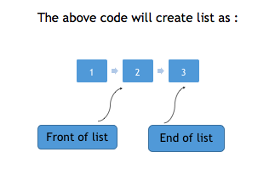
List
include <iostream>
#include <list>
using namespace std;
int main()
{
list<int> l;
}
/* Creates a new empty linked list l */
Similar to vector and array, lists can also be initialized with parameters,
list<int> l{1,2,3};

Slide 43
Practice question
#include <iostream>
#include <list>
using namespace std;
int main()
{
list<int> myList{1,2,3};
/* creates list with 1,2,3 in it */
list<int> myNewList = 1;
/* create list myNewList of integer
and copies value of 1 into it*/
}

Slide 44
Functions in List
empty function :This method returns true if the list is empty else returns false.
size function : This method can be used to find the number of elements present in the list.
front and back function : front() is used to get the first element of the list from the start while back() is used to get the first element of the list from the back.
reverse function :This method can be used to reverse a list completely.
push_back and push_front functions :
push_back(element) method is used to push elements into a list from the back.
push_front(element) method is used to push elements into a list from the front.
pop_front() , pop_back(): pop_front() removes first element from the start of the list. While pop_back() removes first element from the end of the list.

Slide 45
Practice question
#include <iostream>
#include <list>
using namespace std;
int main()
{
list<int> l{1,2,3,4,5};
l.push_back(6);
l.push_back(7);
/* now the list becomes 1,2,3,4,5,6,7 */
l.push_front(8);
l.push_front(9);
/* now the list becomes 9,8,1,2,3,4,5,6,7 */
}

Slide 46
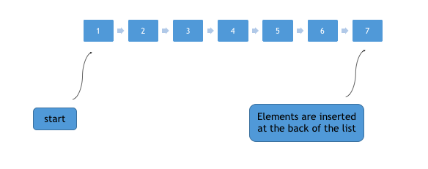
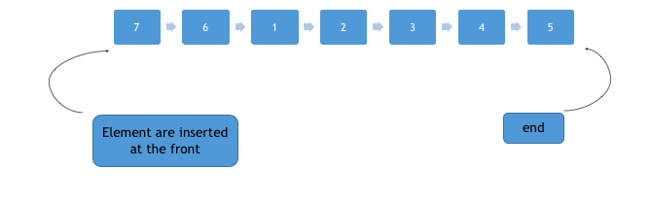
push_back and push_front
push_back(element) method is used to push elements into a list from the back.
push_front(element) method is used to push elements into a list from the front.

Slide 47
Practice question
#include <iostream>
#include <list>
using namespace std;
int main()
{
list<int> l{1,2,3,4,5};
l.pop_back()();
/* now the list becomes 1,2,3,4 */
l.pop_front()();
/* now the list becomes 2,3,4 */
}

Slide 48
Practice question
#include <iostream>
#include <list>
using namespace std;
int main()
{
list<int> l{1,2,3,4,5};
cout<<"size of list = "<<l.size()<<endl; //size is 5
cout<<"Front element in list = "<<l.front()<<endl; //returns 1
cout<<"Back element in list = "<<l.back()<<endl; //returns 5
l.clear(); //clears the list
cout<<"size of list = "<<l.size()<<endl; //size becomes 0
l.reverse();
/* now the list becomes 5,4,3,2,1 */
}
Note: We have not yet printed the list as at() function is not available with list. Have another workaround which we will learn in next class.

Slide 49
MCQ
Which of the following is correct syntax for list creation in C++? list<int> l list<int> l{ 1,2 3} list<int> myNewList = 1; 1 ,2 only 2 ,3 only 1,2 3 1,3

Slide 50
MCQ
Which of the following is correct syntax for list creation in C++? list<int> l list<int> l{ 1,2 3} list<int> myNewList = 1; 1 ,2 only 2 ,3 only 1,2 3 1,3

Slide 51
Practice question
Which of the following function is not available in list container in C++? empty At Front size

Slide 52
Practice question
Which of the following function is not available in list container in C++? empty At Front size

Slide 53

QNA Time
Any Questions??
Any Questions ??

Slide 54
Thank You!
See you guys in next class.

